Slide 1


Course Registration System
Notes:
Hi Everyone,
Good Morning
Before we start with the presentation today, I would like to share a small recital.
We have been a part of Publicis Sapient for almost 3months now, and there is this fact that everyone of us would agree upon.
We all started as fresh graduates, underwent 5weeks or so of rigorous training followed by what…5 weeks now of a Hands On project, and what has transpired in these days is a fact that we all are really proud of. A transformation from someone who could code, to someone who can not only code, but add value to everything he does.
So have we succeeded at becoming a Product engineer?
Hi, I am Rajat, a small part of our big team here.
I am here with my colleagues Aman and Chinmay and we are here to give you a walkthrough of our Transformation, our Journey and the project we have been working for sometime now.

Slide 2
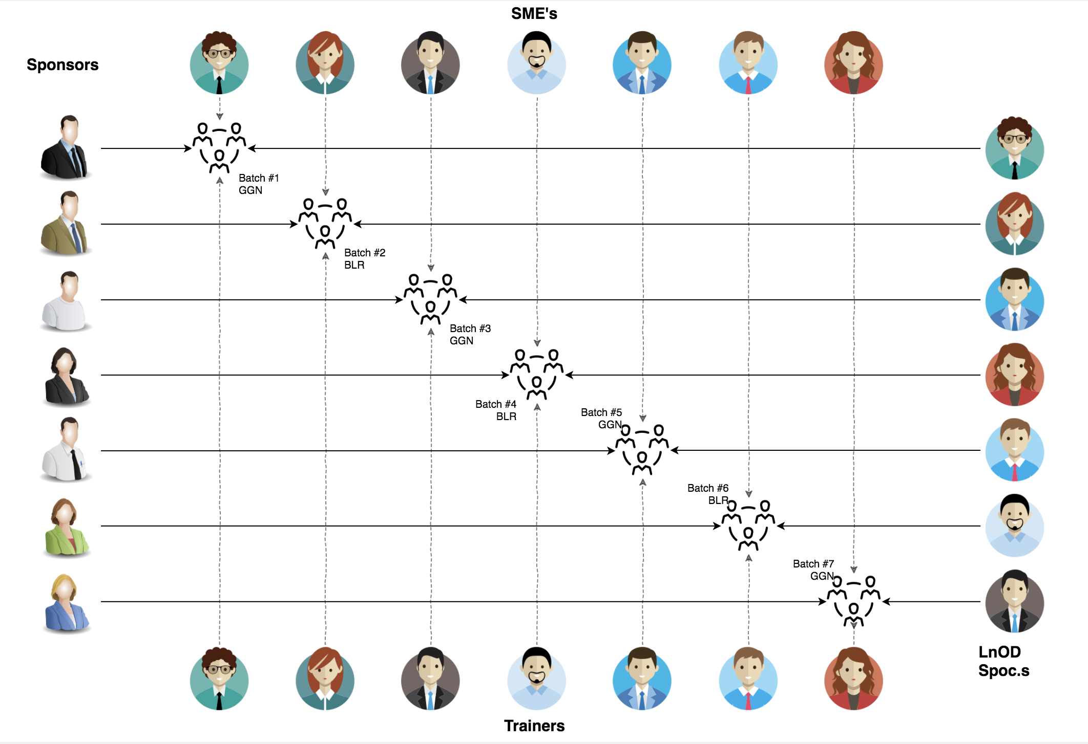
Stakeholders
Sponsors
Flipkart
SME
Amit Balyan
3. HR’s and Coordinates
Anushka Khanna

Slide 3
5 DAYS of Training + Project demo
5 DAYS
40 HOURS
2,400 MINUTES
1,44,000 SECONDS
Limitless knowledge

Slide 4

Agenda
01
Our Journey
02
Our Team
03
Team Structure
04
Problem Statement
05
Engineering Practices
06
Tech Stack
07
Development
08
Challenges & Learnings
09
Demo
10
Questions
Notes:
Time – 1 min

Slide 5
Our Journey
Notes:
Time - 2 mins

Slide 6
Demo
Mindset
Process
5
project Demo
Tools
4
Adapting to a developer
Mindset
Comprehend
3
Design Thinking through UML Artifacts
2
Decide the Technologies JAVA/MySQL/JDBC
1
Understanding Project Goals

Slide 7
ACTION PLAN
 | Modules | Description
Day1 | GIT UML Diagrams | Understanding Git commands Requirement understanding and design UseCase and Class diagram
Day2 | Java17 | Creating foundational Java packages like Clients, Business, Bean. Structured the packages by skeleton code
Day3 | Java17 Interface MySQL Exception Handling | Defined interfaces for classes, Created Date access objects (dao) package using JDBC. Implemented exception handlers.
Day4 | Date and time api For each loop api Stream api Documentation | Api ensures tracking when specific actions like registration process occurred and Integration. DropWizard framework for documentation

Slide 8
Our next starts
NOW
Notes:
Time – 1 min
Swati

Slide 9

Our Team
Notes:
Time – 2 mins

Slide 10
Name | Responsibility
Vartika | Use case diagram, DAO, Service, Business
Rohan Mitra | DAO, Services , Business, Testing
Srujana Sri Rasaputra | Business , Presentation
Dama Asritha Vyshnavi | Business, Presentation
Rishabh | Bean, Exceptions
Prajwal | Bean, Exceptions
Shivali | Class diagram, Exceptions
Notes:
Name alongwith responsibilities

Slide 11

Project Goals
Notes:
Time – 3 mins

Slide 12




Our Vision
Our vision for the new student registration system is to create a modern and user-centric platform that enhances the academic journey for both students and faculty members.
For students : The system will offer an intuitive and easy-to-use interface, allowing them to navigate through course options, select preferred courses, manage schedules, access report cards, and handle bill payments seamlessly. Comprehensive course details, including professors, department information, and prerequisites, will be readily available, empowering students to make informed decisions about their academic pursuits. Additionally, students will enjoy flexibility in adjusting course schedules within the designated add/drop period, enabling them to tailor their academic plans according to their evolving needs and preferences.
For faculty members: The system will provide efficient course management tools, allowing instructors to easily indicate the courses they will be teaching and view the list of enrolled students. This simplifies the course management process, ensuring instructors can focus more on teaching and less on administrative tasks. Furthermore, a streamlined process for securely recording and managing student grades will be implemented, enabling faculty members to efficiently track and manage student academic performance.'
1
2
Quality
Security
3
4
Interactivity
Speed
Notes:
User satisfaction and brand value
Problem Statement

Slide 13

Engineering Practices
Notes:
Time – 5 mins

Slide 14
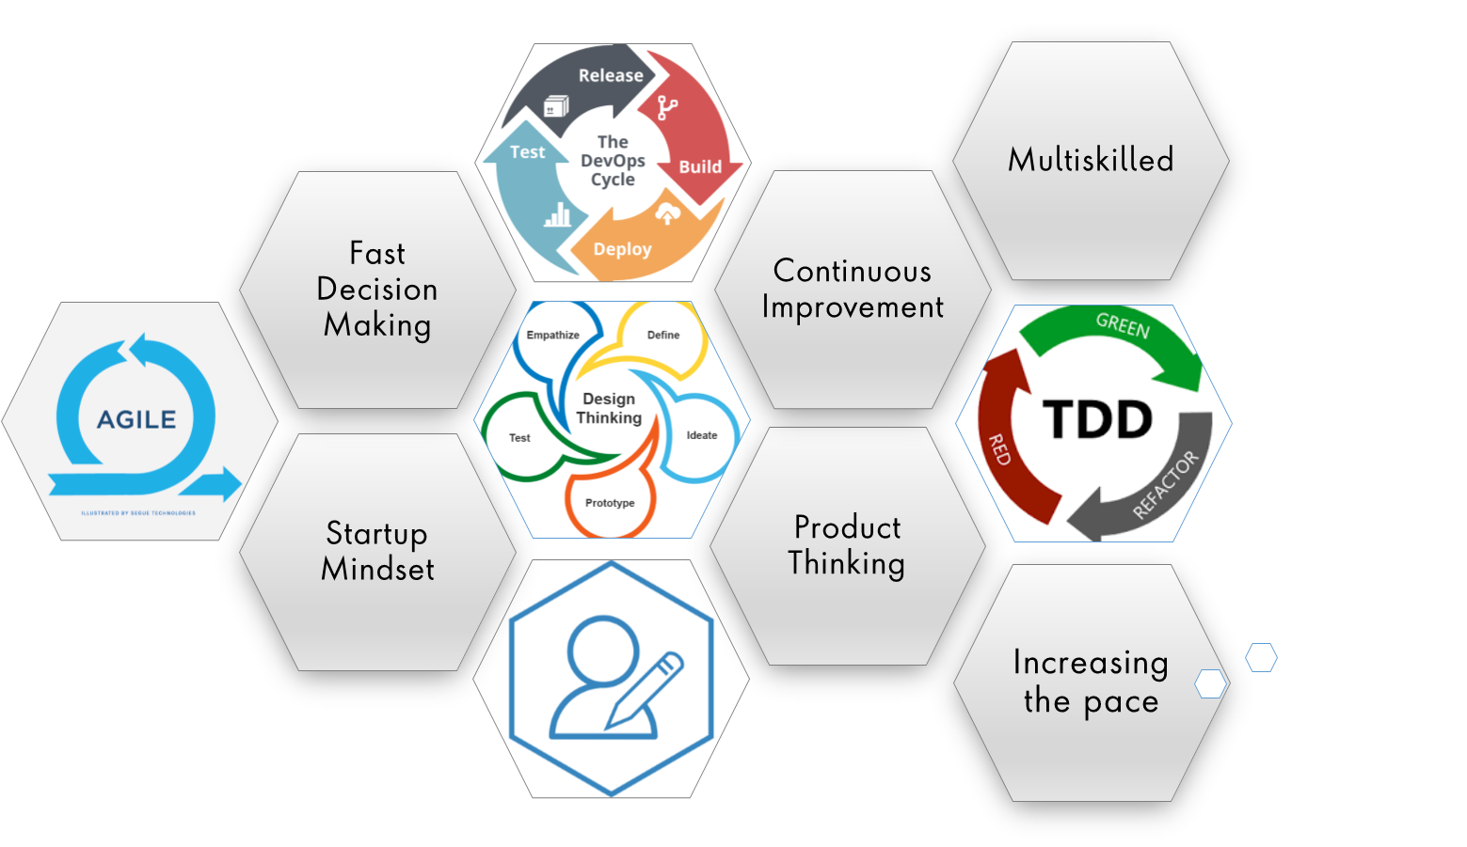
Notes:
Product Thinking (Design Thinking, Requirement Analysis, )
Multi Skilled (Frontend, Backend, DevOps)
Fast Decision Making (Agile)
Increasing the Pace (Automation CI/CD)
Startup Mindset (Agile)
Continuous Improvement (Retros)

Slide 15
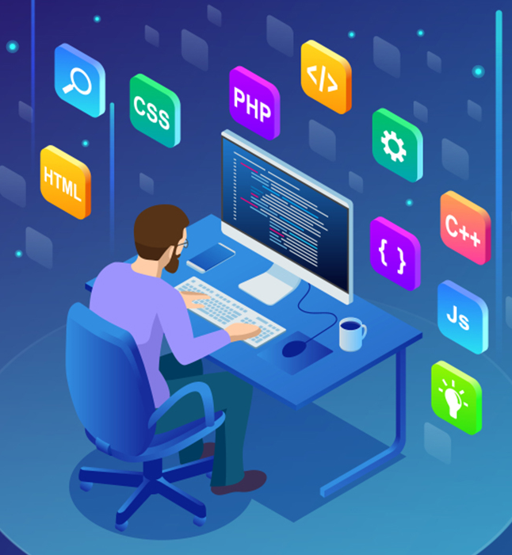
Tech Stack
Notes:
Time – 2 mins

Slide 16





Designing
Backend
Testing
Data
SCM
UML
Core Language
Tools
SQL Database
Code Collaboration
Framework
Notes:
Time – 1 min
Java
Maven
DropWizard
MySQL
Jersey
GitHub
Postman / ARC (Check it)
StarUML / Dia / Lucid Charts
List
Design
Backend
Testing
Tools

Slide 17

Development
Notes:
Time – 1 min

Slide 18
Use case and Class
Diagram
Creating required Java Packages and classes, database
Understanding the Problem Statement
System Planning
Sprint Implementation
Running the code
Implement the Java methods
Data base Connection
Notes:
Time – 1 min

Slide 19
UML MODELLING
As a part of software designing phase, we used UML modelling language for representing problem into graphical form as per best engineering practices.

Slide 20
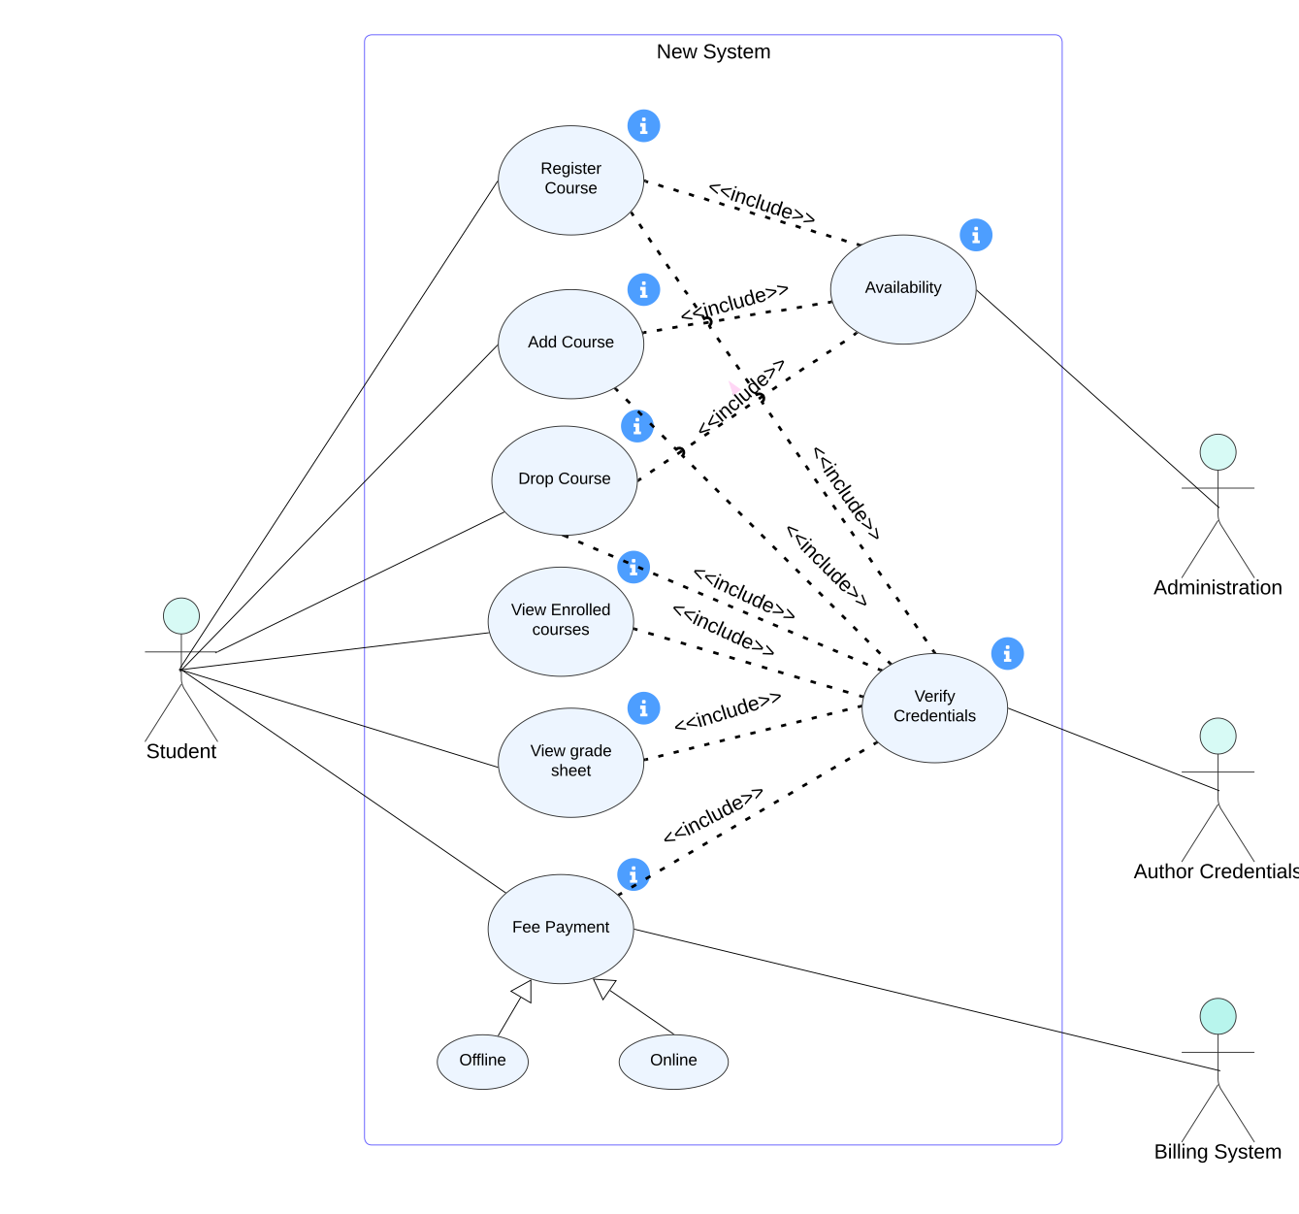
1. Use Case
Diagrams

Slide 21
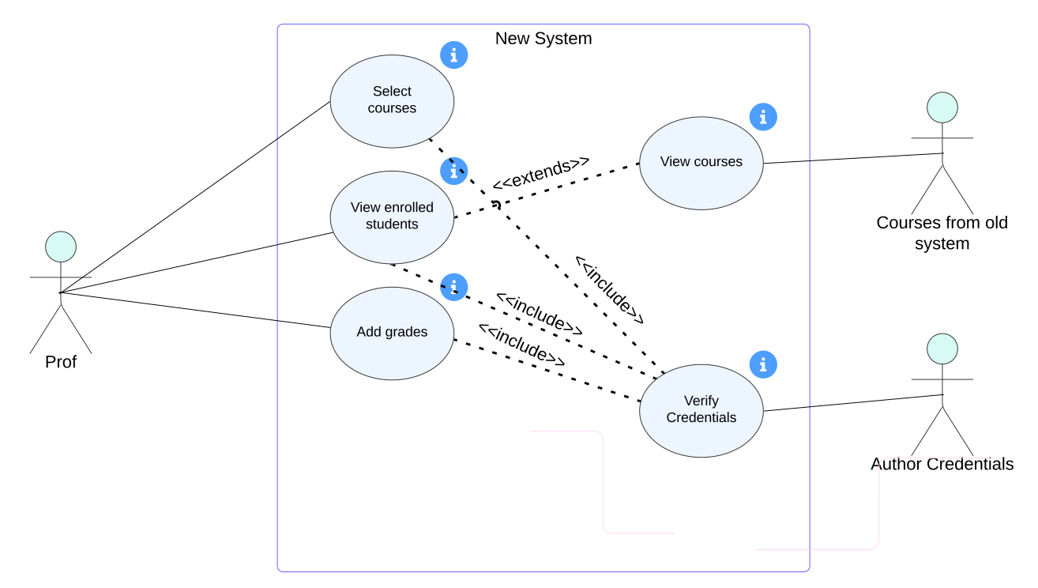

Slide 22
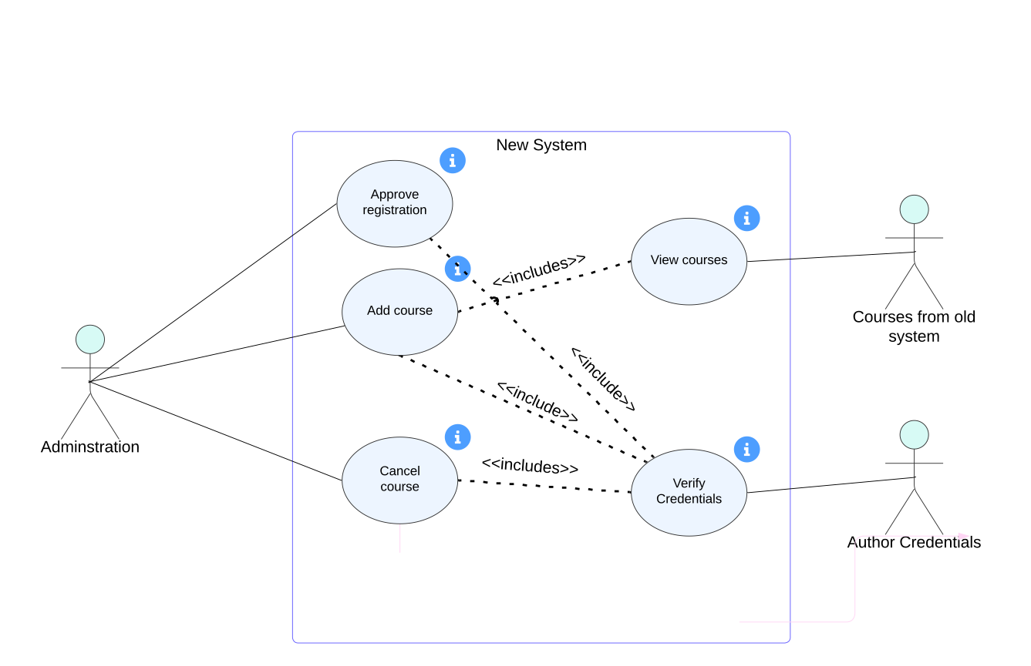

Slide 23
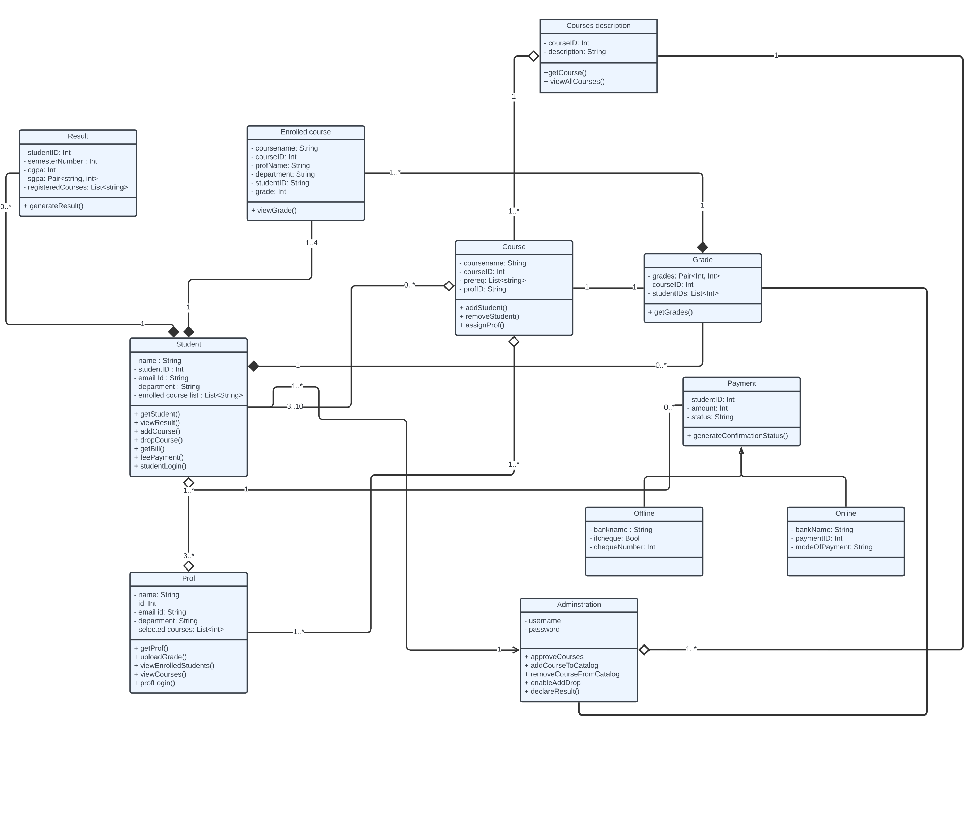
2. Class Diagram

Slide 24

Challenges & Learnings
Notes:
Time – 2 mins

Slide 25
 | Challenges | Learning
Day 1 | Understanding the problem statement Collaboration issues such as merge conflicts in Git UML diagram conventions | Git commands UML Diagrams
Day 2 | Understanding Object Oriented Approaches | Java 17
Day 3 | Connecting the database | Interface, Exception Handling, data access objects(dao)
Day 4 | Understanding and incorporating Input streams and date time API | API, drop wizard

Slide 26

Demo
Notes:
Time –
Architecture – 5 mins
NFR Dashboard – 3 mins
Demo – 10 mins
1. Show the Responsiveness and Wave tool first

Slide 27

Questions
Notes:
Time - ?

Slide 28
Thank you
Notes:
Time – After this show the testimonial video. 1 min

